Slide 1
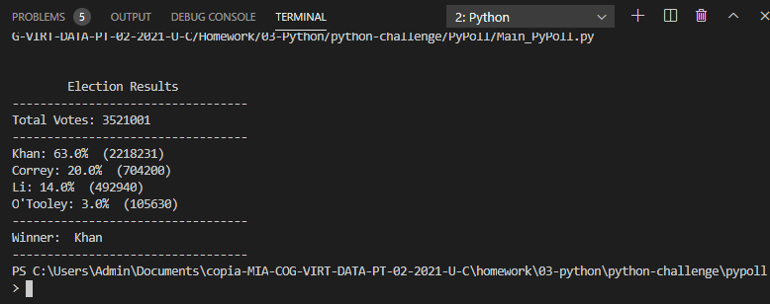
Solution PyPoll results

Slide 2
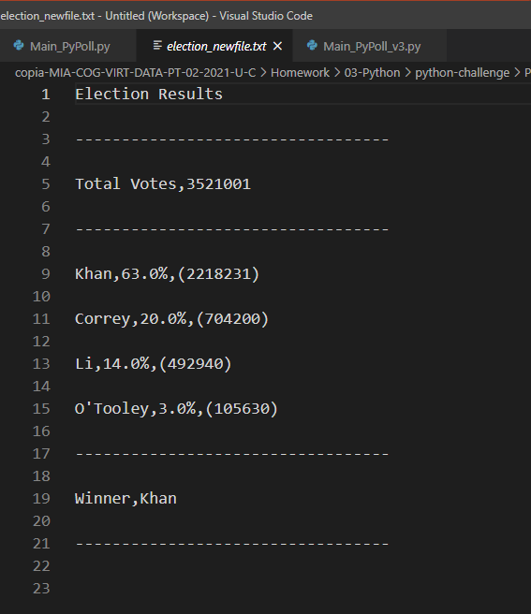
New file.txt with csv format exported

